Slide 1
0
Team Introduction

Slide 2
1
Business Overview
Entrepreneurship Education for
Chinese High School Student

Slide 3
1.1 Industry Overview: Huge Potential, Ignored.
1. Top-down: Governmental Substantial Support
2. Bottom-up: High School Students ARE interested in Startup

Slide 4
1st : 2019
Starting at Jan. 2015:
1st National College Startup Contest (4M Participants)
Starting at Oct. 2019:
1st National High School Startup Contest

Slide 5
71%
“71% of the interviewed* high schoolers are ‘Somewhat Interested’ or ‘Very Interested' in learning entrepreneurship.”
--Junior Achievement Annual Report
*: Interviewees consists of 696 student from both Key (Magnet) and non-Key Chinese Public High School

Slide 6

Our Problem
Our Solution
Existing online entrepreneurship education resources are too advanced (MBA-level) and tedious for high schooler to absorb effectively
Lack ways to implement theories into realistic scenarios
Startup Simulation Game that allows players to make critical decisions for their virtual company based on the scenarios given.
Game Mechanism Explanations (i.e. Why you should make decision XYZ) by experts.

Slide 7
1.2 Customer Persona + Product Use Case

Slide 8

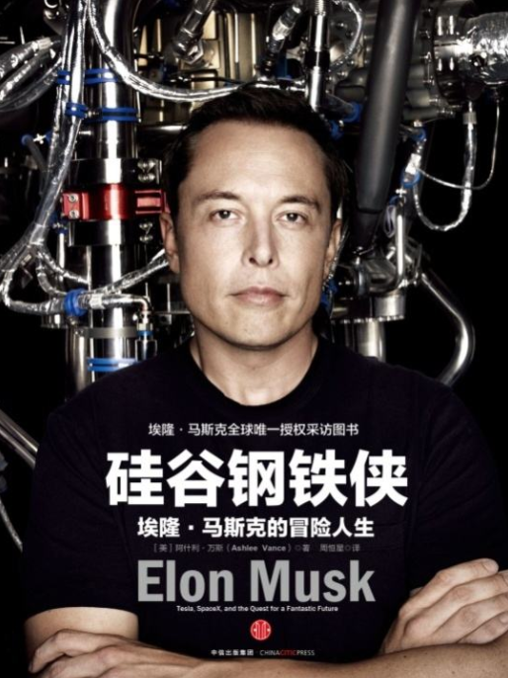
Lily Zhang
- 2nd year high school student
- Top 10% at a key public high school
- Love physics and entrepreneurship
What made Elon decided to work on the idea of PayPal?
Lily never misses her favorite TV show Shark Tank during weekend. Inspired by the grand story of Elon Musk, she has some fantasy regarding founding a world-changing company in the future.
However, entrepreneurship is not taught in school – and she will be too busy with school work to attend even if it’s offered.
Sometimes, Lily would spend her 30-minute spare time finding answers in books or through online videos; Yet they raised more questions than answers.

Slide 9
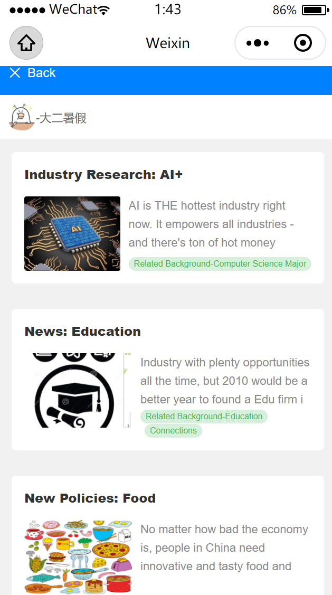
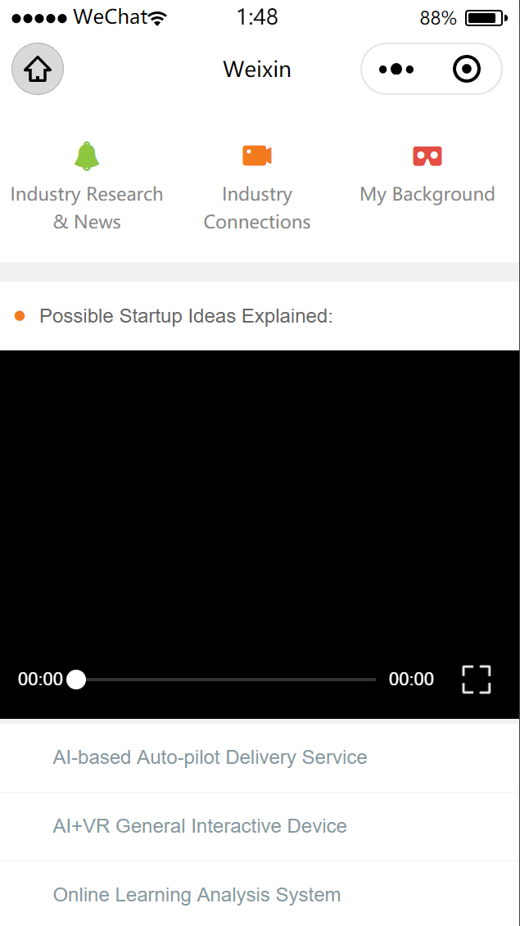
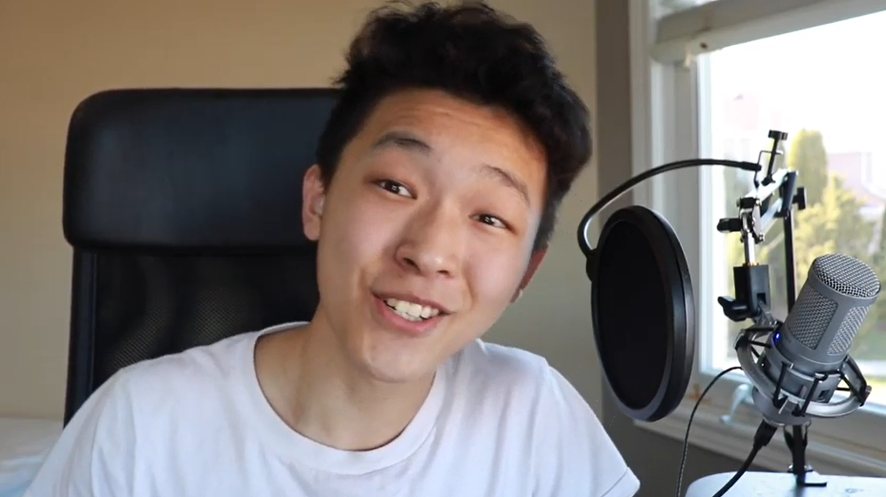
How we help:
Lily learnt right away why her decisions are bad for her company from experienced teenage entrepreneurs/professors
Lily practiced decision making based upon various realistic information sources we provide

Slide 10
2
Market Analysis & Competition

Slide 11
2.1 Market Sizing

Slide 12
July 2021 – Jan 2022
20M
Domestic Adjacent Market + Original Market
All Chinese high school and college students
10M
Feb 2021 – June 2021
Domestic Market
All Chinese high school students
Agust 2020 – Jan 2021
1M
Niche Market
Elite Chinese high school students

Slide 13
2.2 Competitive Landscape

Slide 14
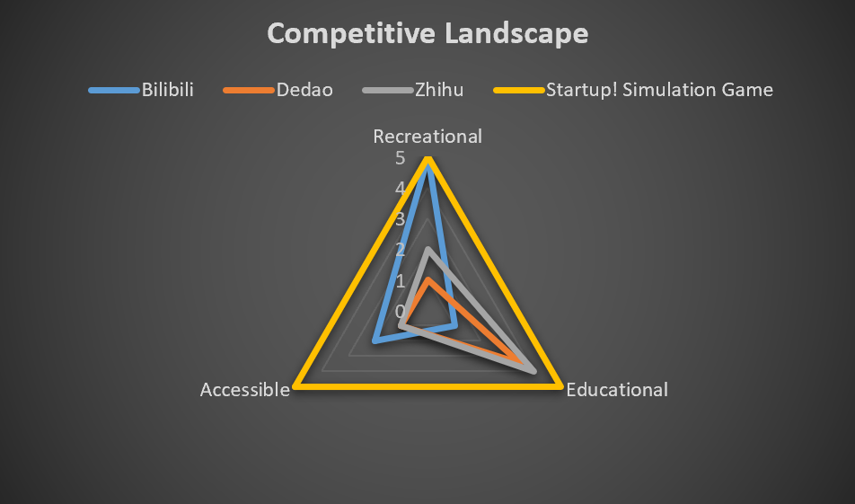
Top 3 User Priority: 1. Recreational 2. Educational 3. Accessible

Slide 15
3
Sales and Finance Plan

Slide 16
Freemium
Game: Free
Game Explanations: Charged
All game chapters are freely accessible.
Fee required to unlock most explanation videos & text.

Slide 17
To C
To B
Premium Sales Plan
Individual Quarterly Subscription Fee: $9.9
Organizational Quarterly Subscription Fee: $99.9

Slide 18
Premium Sales Plan
Organizational Quarterly Subscription Fee: $99.9
For High School Experimental Lecture:
Entreprenuership Course teaching material
For Student Club:
Materials for fun club actvities
For non-traditional K12 education firm:
Materials for daily teaching
To B
More scenarios…
2 student organizations already expressed interests
1 school administrator responded “cooperation is highly possible”

Slide 19
Marketing Channels
New Media
Offline publicity Events
Share in WeChat Official Accounts & Moments.
Do flashes in schools; Show up in school public events.
Phone-call
Proposal
Exploit connections with high school management teams.
Propose for official cooperation with schools.

Slide 20
Break-even Analysis
High Profit Next Step
Profit Win publicity
Break Even Trigger the flywheel
April 2021
Loss (-$1700) Start marketing campaigns and show tractions
Big Loss (-$5700) Focusing heavily on product

Slide 21
$30,000
10% Equity + Advisory Board
100% Spent on Product Development
Angel Investment Intention
for

Slide 22
50% Market Share
Defining Success
In 2 years

Slide 23
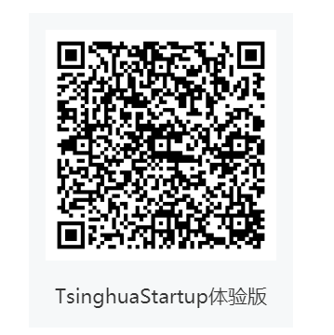
THANKS!
Try the MVP for our app!

Slide 24
Appendix:
Finance Projections in detail, Comeptition Analysis and more
03

Slide 25
Roadmap, metrics milestones
1000 User Acquired
Milestone #1
MVP Launched + Iterations
Milestone #2
1000 Users (10% of the niche market) acquired
Milestone #3
Partnership school acquired

Slide 26
Measuring Success
One Number that Matters: Total Active User
MAU Play 3 or more times a month
Expansion MAU increase by 20% a month/campus
CVR Ratio of Users to Paying Users

Slide 27
Measuring Success
Stickiness:
Create and cultivate user community
Host offline bonding activity to connect high school entrepreneurs
Deliver weekly newsletter to attract users’ attention
Scale:
Referral -> 30 free trial of premium features
Word of mouths
Show up at campus publicity events

Slide 28
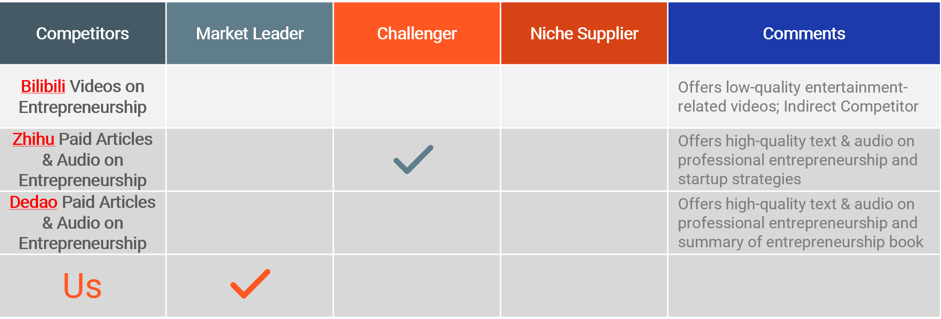
Competitors

Slide 29
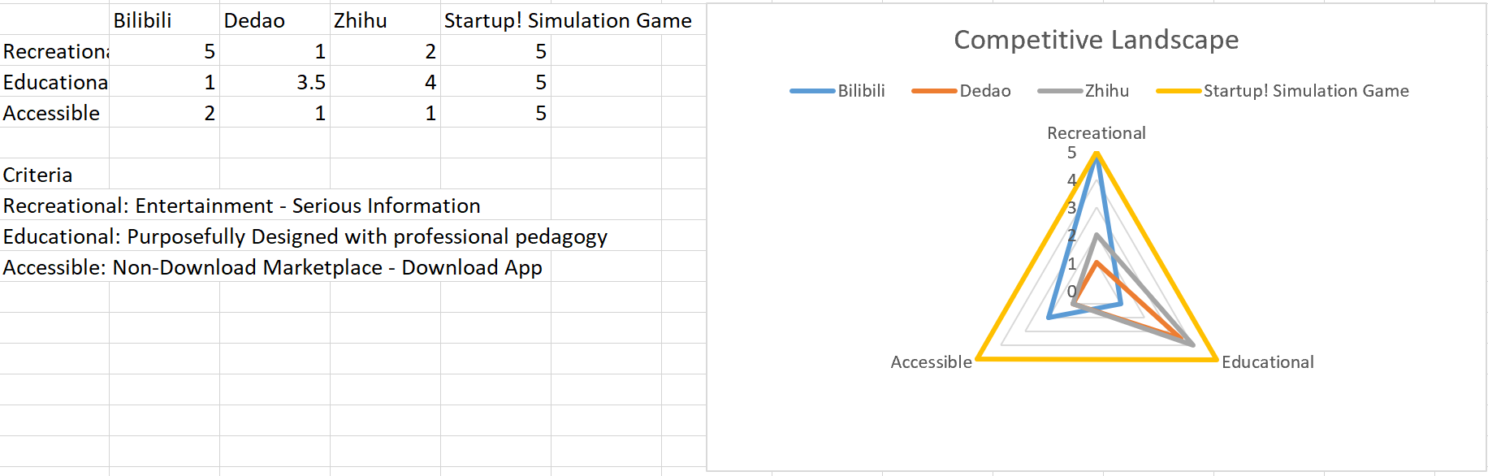
Competitive Landscape

Slide 30
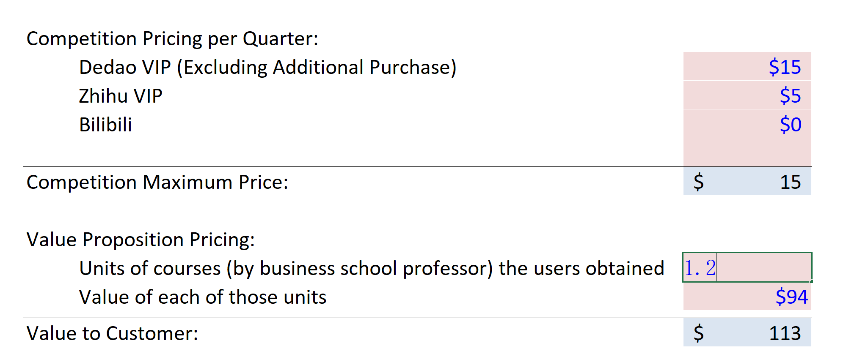
Individual Pricing Strategy
– Combination of Value-based and Competition-based approach

Slide 31
MIT Sloan MBA Professor Cost: $136,107 = 1 year = 1440 hours ->$94/hour * 0.1hour/week ->$9.4/week -->$500/year

Slide 32
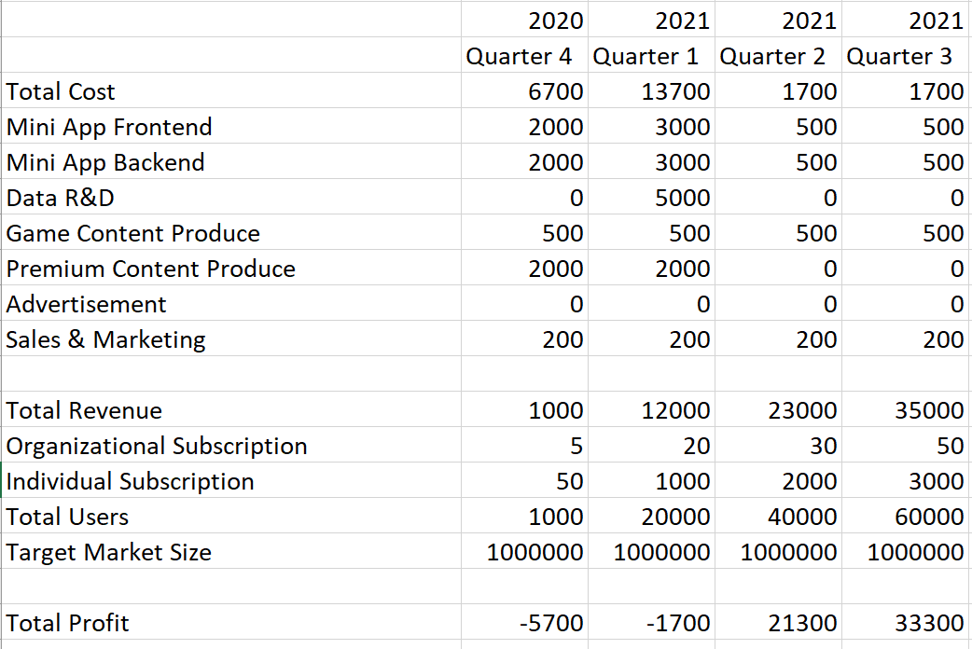
MIT Sloan MBA Professor Cost: $136,107 = 1 year = 1440 hours ->$94/hour * 0.1hour/week ->$9.4/week -->$500/year
Conversion Rate: 5% Market Share: 10% Total User: 10% * 1M = 10w Total Paying User: 10w * 5% = 5000 $500
Finance Projection

